Slide 1
TIME & WORK

Slide 2
Introduction
Here, we need to relate the efficiency of workers and the total amount of work to be done so that the time required to complete the work can be identified.
Approaches:
One day work (Fraction method)
LCM approach
Efficiency approach

Slide 3
One day work approach
If A can complete a work in ‘n’ days then the amount of work done by A in one day is given by ‘1/n’.
In this approach, the total work to be done is considered as 1.
Example:
A alone can do a piece of work in 10 days and B alone can do the same work in 15 days. If they both are working together then in how many days, the work will get completed?
Solution: One day work of A = 1/10
One day work of B = 1/15
Combined one day work of A and B = 1/10 + 1/15 = 1/6
If A and B together can do 1/6 of total work in one day then they will complete 1 (total work) work in 6 days.

Slide 4
LCM Method to Solve Problems
Here we take the LCM of time taken by the members to do the complete work
That LCM will behave as a value of total work
Total Work = LCM
Total Work = No of days * work done in 1 day (per unit time)
Thus, No of days = LCM/Efficiency
where efficiency = work done in per unit time

Slide 5
LCM approach
Here, the total work is assumed as the LCM of the individual number of days.
Example:
A alone can do a piece of work in 10 days and B alone can do the same work in 15 days. If they both are working together then in how many days, the work will get completed?
Solution:
A = 10 3
30
B = 15 2
Work done by A and B in one day = 3+2 = 5
Number of days = Total work/work done in one day
Number of days = 30/5 = 6

Slide 6
Example : A completes a work in 10 days where as B completes the same work in 12 days. In how many days they will complete the work by working together?
Solution:
LCM of 10 & 12 = 60
Thus total work = 60
Efficiency of A = 60/10 = 6
Efficiency of B = 60/12 = 5
Efficiency of A and B together = 11
Thus Time taken by A and B together is = 60/11 days

Slide 7
Example : If Arti and Rita can do a job in 8 hours (working together at their respective constant rates) and Art can do the job alone in 12 hours. In how many hours can Rita do the job alone?
Sol: Arti + Rita = 8
Arti = 12
LCM = 24
Let’s consider 24 units as total work.
Work done by Arti in one day = 2 units
Work done by Arti and Rita together in one day = 3 units
Thus, work done by Rita alone in one day = (3 – 2) 1 unit
No. of days taken by Rita to complete the job alone = 24/1 = 24.

Slide 8
Efficiency Technique
Work done by a person in unit time is defined as efficiency in Time and Work
Problems
A can complete a work in 10 days so efficiency of A per day = 100/10 = 10%

Slide 9
Example : If a person can complete his work in 5 days. What will be his efficiency?
We have: 100/5 = 20%. Therefore, the person’s efficiency is 20%.
Summarizing this, we can say that if a person can do his job in n days, his efficiency will be given as below:
Efficiency =(100/n) %.
1.A is 30% more efficient than B. How much time will B alone take to complete a job which A alone could have done in 20 days?
A.13 B .26 C.17 D.46
Ans: B

Slide 10
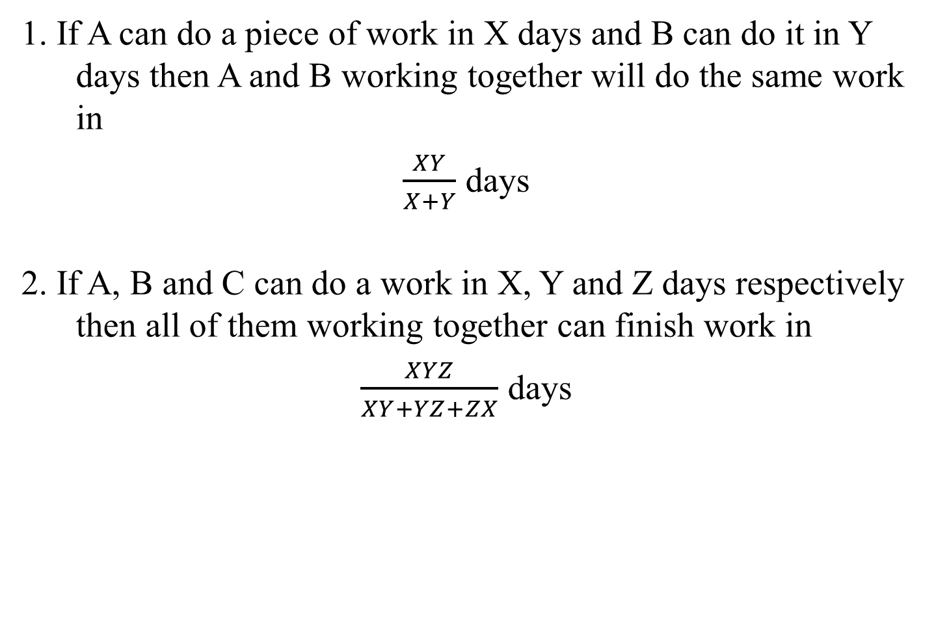
FEW CONCEPTS
1. If A can do a piece of work in X days and B can do it in Y days then A and B working together will do the same work in
$\frac{XY}{X+Y}$ days
2. If A, B and C can do a work in X, Y and Z days respectively then all of them working together can finish work in
$\frac{XYZ}{XY+YZ+ZX}$ days

Slide 11
PRACTICE QUESTIONS
1. A completes the work in 10 days and B completes the work in 15 days In how many days they will complete the work.
A. 6 B. 7 C. 5 D. 8
SOL. A
2.A can finish a work in 18 days and B can do the same work in 15 days. B worked for 10 days and left the job. In how many days, A alone can finish the remaining work?
A. 5 B. 7 C. 6 D. 8
Ans: C
Notes:
1. Work done by A in 1 day = 1/10
Work Done by B in 1 day = 1/15
Work done By A & B together in 1 day = 1/10 + 1/15 = (3+2)/30 = 5/30 = 1/6
As A & B Completes 1/6 work in one day So they will complete the whole work in 6 Days.
2. LCM of 18 and 15 = 90
Efficiency of A and B is 5 and 6 respectively
10 days work of B = 6*10 = 60
Remaining work = 30
No of days taken by A to complete remaining work = 30/5 = 6 days

Slide 12
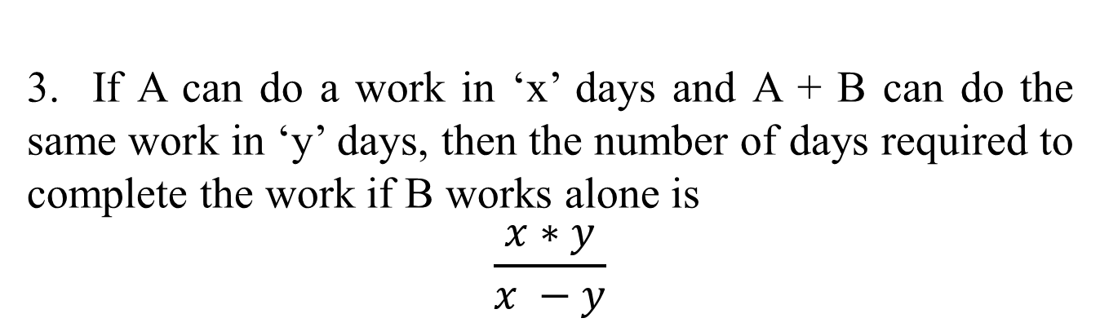
3. If A can do a work in ‘x’ days and A + B can do the same work in ‘y’ days, then the number of days required to complete the work if B works alone is
$$\frac{x∗y}{x −y}$$

Slide 13
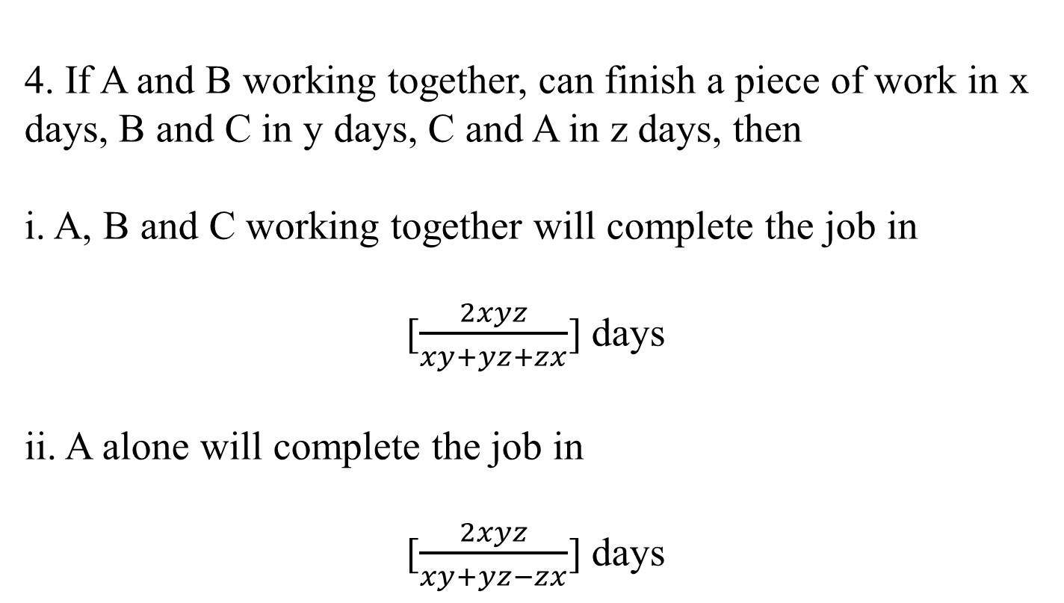
4. If A and B working together, can finish a piece of work in x days, B and C in y days, C and A in z days, then
i. A, B and C working together will complete the job in
[$\frac{2xyz}{xy+yz+zx}$] days
ii. A alone will complete the job in
[$\frac{2xyz}{xy+yz−zx}$] days

Slide 14
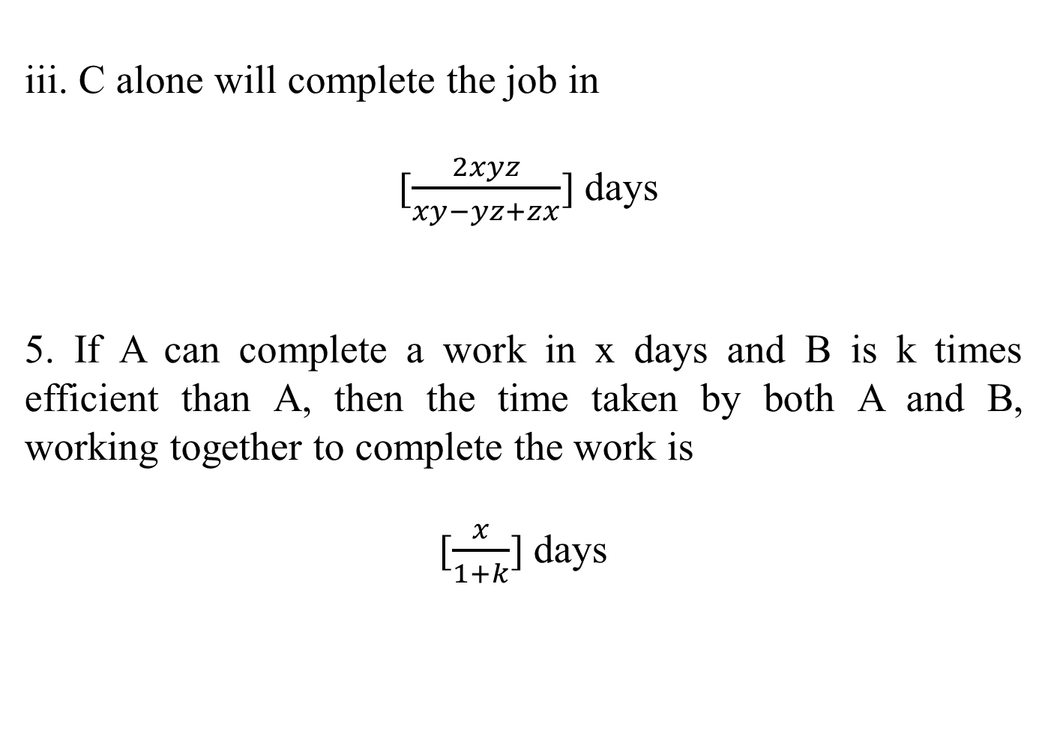
iii. C alone will complete the job in
[$\frac{2xyz}{xy−yz+zx}$] days
5. If A can complete a work in x days and B is k times efficient than A, then the time taken by both A and B, working together to complete the work is
[$\frac{x}{1+k}$] days

Slide 15
EXAMPLE :
Sakshi can do a piece of work in 20 days. Tanya is 25%more efficient than Sakshi. The number of days taken by Tanya to do the same piece of work is:
A.15 B.16 C.25 D.27
Explanation:
Ratio of times Sakshi and Tanya = 125 : 100 = 5 : 4.
Suppose Tanya takes x days to do the work.
5 : 4 :: 20 : x
x = 4 x 20/5
x = 16 days.
Hence, Tanya takes 16 days to complete the work.

Slide 16
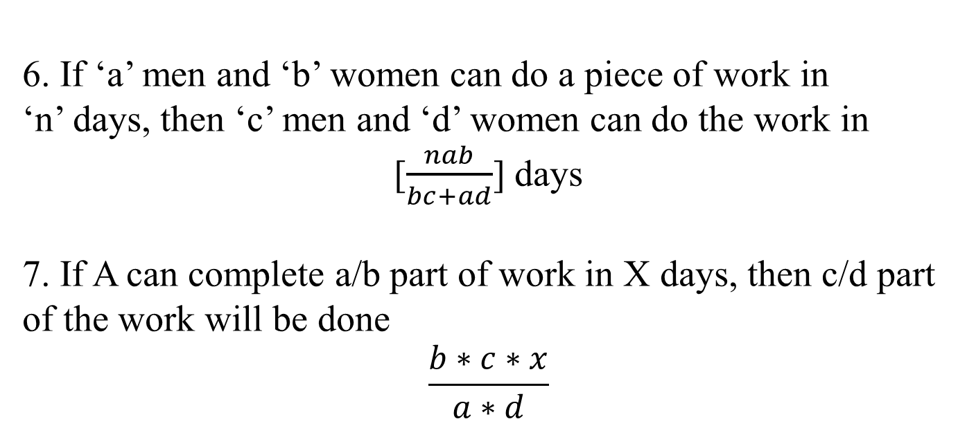
6. If ‘a’ men and ‘b’ women can do a piece of work in ‘n’ days, then ‘c’ men and ‘d’ women can do the work in
[$\frac{nab}{bc+ad}$] days
7. If A can complete a/b part of work in X days, then c/d part of the work will be done
$$\frac{b∗c∗x}{a∗d}$$

Slide 17
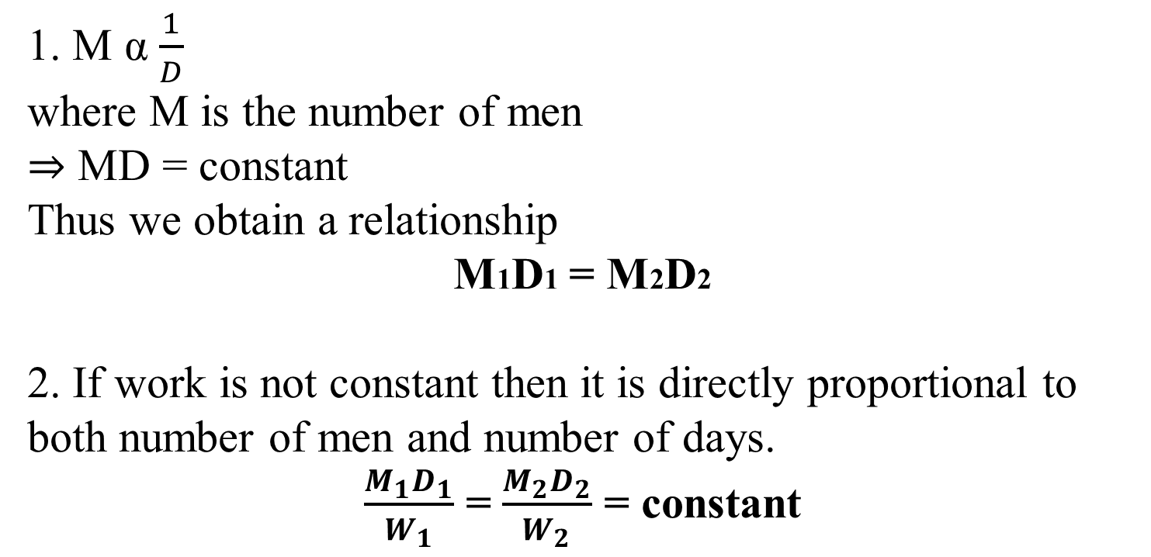
CONCEPT : Men v/s Days
1. M α $\frac{1}{D}$
where M is the number of men
⇒ MD = constant
Thus we obtain a relationship
M1D1 = M2D2
2. If work is not constant then it is directly proportional to both number of men and number of days.
$\frac{M_{1}D_{1}}{W_{1}}$ = $\frac{M_{2}D_{2}}{W_{2}}$ = constant

Slide 18
Example: 45 people take 18 days to dig a pond. If the pond would have to be dug in 15 days, then the number of people to be employed will be:
A case of inverse proportion in which more people would take less day
Number of people required = (45 x 18)/15 = 54 people
Example: 76 ladies complete a job in 33 days. Due to some reason some ladies did not join the work and therefore it was completed in 44 days. The number of ladies who did not report for the work is ______.
Solution: M1*D1*T1/W1 = M2*D2*T2/W2
Work requires 76 x 33 = 2508 man days
If N ladies did not report for work
Then (76 – N) x 44 = 2508
76 - N = 2508/44 = 57
N = 76 – 57 = 19

Slide 19
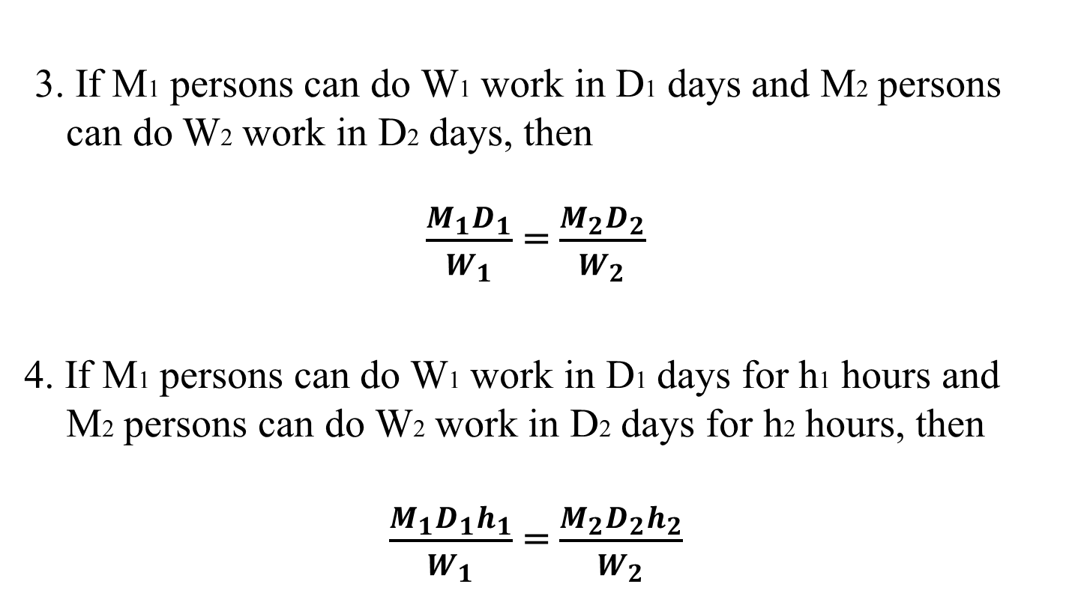
3. If M1 persons can do W1 work in D1 days and M2 persons can do W2 work in D2 days, then
$\frac{M_{1}D_{1}}{W_{1}}$ = $\frac{M_{2}D_{2}}{W_{2}}$
4. If M1 persons can do W1 work in D1 days for h1 hours and M2 persons can do W2 work in D2 days for h2 hours, then
$\frac{M_{1}D_{1}h_{1}}{W_{1}}$ = $\frac{M_{2}D_{2}h_{2}}{W_{2}}$

Slide 20
PRACTICE QUESTIONS
1.Three persons Ram, Shyam and Kamal can do a job in 10 days, 12 days and 15 days respectively. In how many days can they finish the job working together?
5 B 4 C. 6 D. 7
SOL.B
2. Tannu and Rekha can do a job in 12 days. Rekha alone can finish it in 36 days. In how many days can Tannu and alone finish the work?
15 B. 16 C. 18 D. 19
SOL.C
Notes:
1.
LCM of 10, 12 and 15 = 60
Eff of Ram shyam and kamal = 6,5 and 4 resp
Eff together = 15
Time = 60/15 = 4
2. LCM = 36
Eff of T+R = 3
Eff of R = 1
So T = 2
Time = 36/2 = 18

Slide 21
3. Deepak and Anil can do a piece of work in 10 days and 30 days respectively. They work together and Deepak leaves 5 day’s before the work is finished. Anil finishes the remaining work alone. In how many days is the total work finished?
A.11.35 days B.11.25 days C.11.30 days D.11 days
SOL.B
4. Shambhu is twice as good as workman as Bablu and together they finish a piece of work in 18 days. Find the total number of days in which Bablu can finish the work.
A. 27 days B. 54 days
C. 56 days D. 68 days
SOL.B
Notes:
3. Assume the time for completion = T
Since Deepak leaves 5 days before the work is finished. So, no. of days worked by Deepak = T – 5 and Anil works, so, number of days worked by Anil = T
Deepak’s work + Anil’s work – 1
(T-5/10)+T/30=1
T=11.25
If shambhu does 2 unit work then Bablu does 1 only
In 18 days they do = 54 unit
Time taken by bablu = 54/1 = 54 days

Slide 22
5. Ritu can complete a piece of work in 5 days, but with the help of her son she can do it in 3 days. Find the time taken by the son alone to complete the work.
A. 7.5 days B. 13 days C. 11 days D. 9 days
SOL.A
6. 4 men and 6 women working together can complete the work within 8 days. 3 men and 7 women working together will complete the same work within 10 days. In how many days 10 women will complete this work?
60 B.40 C.70 D.10
SOL.B
Notes:
5. where we have one person work and together work done. Then we can easily get the other person work just by subtracting them. As, Son's one day work = (1/3 −1/5 )=(5−3/15 )=2/15
So son will do whole work in 2/15 days = 7.5 days which is =7.5 days

Slide 23
7. 24 men working 8 hours a day can finish a work in 10 days. Find the number of men required to finish the same work in 6 days working 5 hours a day?
A. 60 B. 64
C. 80 D. 72
SOL.B
8. A work could be completed in 100 days by some workers. However, due to the absence of 10 workers, it was completed in 110 days. The original number of workers was:
A. 100 B. 110
C.55 D. 50
E. None of these
SOL.B
Notes:
6. 4M+6W×8D =32+48
3M+7W×10D =30+70
32M-30M=2M
70W-48W=22
2M=22W 1M=11W
(4M×11W)+6 =50×8/10
400/10 =40DAYS.
ANSWER IS 40 DAYS.
7. 24*8*10 = 6*5*x
X = 64

Slide 24
9. A can do a work in 12 days. When he had worked for 3 days, B joined him. If they complete the work in 3 more days, in how many days can B alone finish the work?
A. 6 days B. 12 days C.4 days
D. 8 days E. None of these
SOL. A
10. A is thrice as good a workman as B, therefore, A is able to finish a piece of work in 60 days less that B. The time (in days) in which they can do it working together is:
A. 22 B. 22 ½ C. 23
23 1/4 E. None of these
SOL.B
Notes:
11. A completes the work in 12 days. Work done by A in 3 days = 3 units
Remaining work is 9 units
And this is done by A and B in 3days
Which means 3 unit in a day where B works 2 unit
Therefore Time for B = 12/2 = 6 days
10. A’s eff = 3 and B’s = 1
Ration of time taken by A and B = 1:3
2 units = 60
1 unit = 30
Time taken together = 90/4 = 22.5

Slide 25
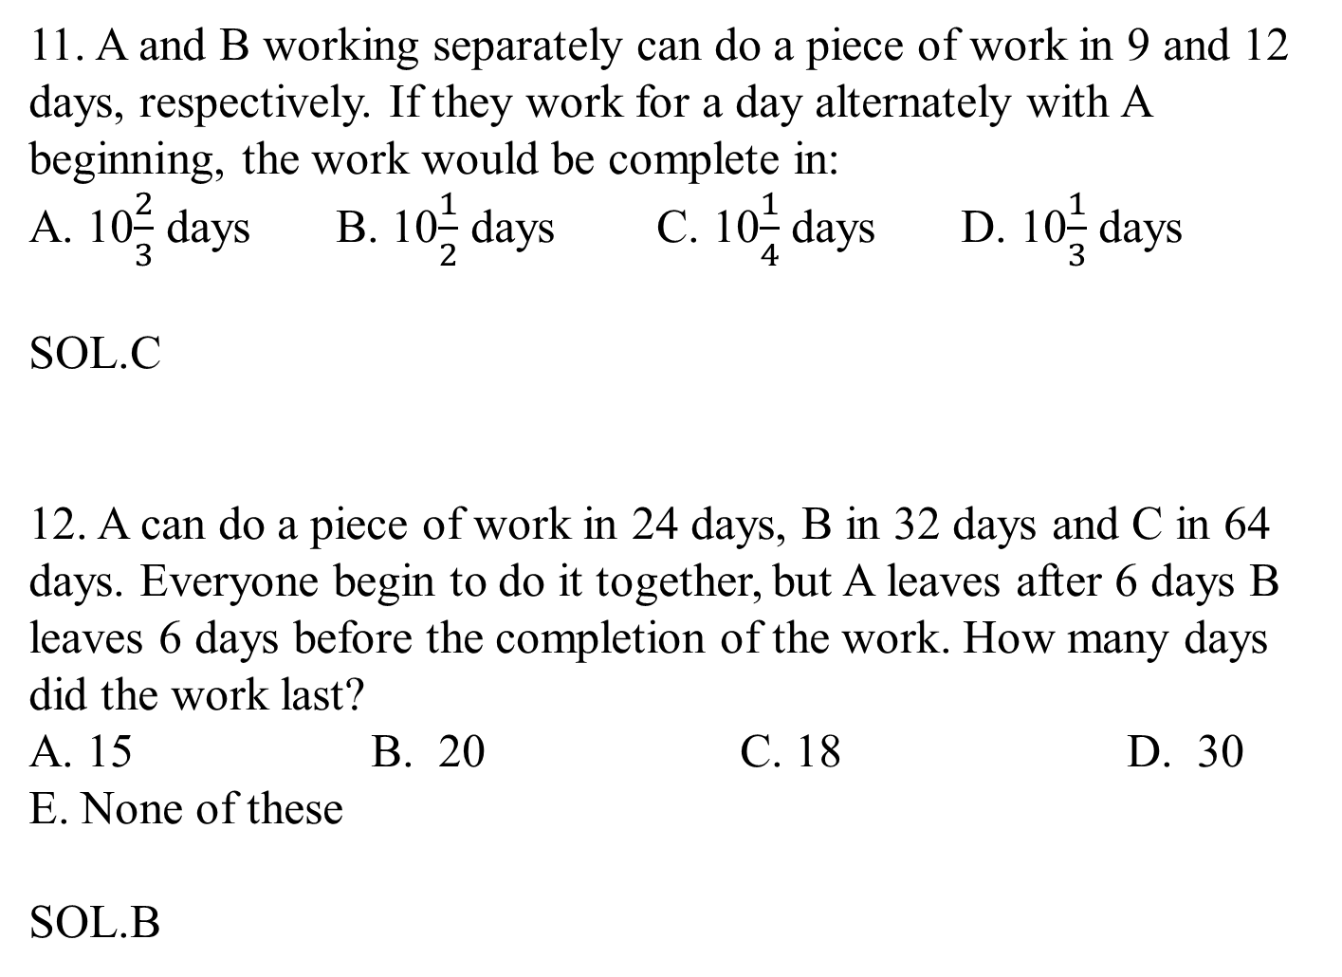
11. A and B working separately can do a piece of work in 9 and 12 days, respectively. If they work for a day alternately with A beginning, the work would be complete in:
A. 10$\frac{2}{3}$ days B. 10$\frac{1}{2}$ days C. 10$\frac{1}{4}$ days D. 10$\frac{1}{3}$ days
SOL.C
12. A can do a piece of work in 24 days, B in 32 days and C in 64 days. Everyone begin to do it together, but A leaves after 6 days B leaves 6 days before the completion of the work. How many days did the work last?
A. 15 B. 20 C. 18 D. 30
E. None of these
SOL.B
Notes:
11. Portion of the work done by A and B in first two days=1/9+1/12=7/36
Portion of work done in the first 10 days=35/36
Remaining work=1-35/36=1/36
Therefore, time taken by
A =1/36*9=1/4 day
Hence, total time=10+1/4=10(1/4) days.
12. A = 24 days B = 32 days C = 64 days. Fraction of work done in one day by A = 1/24 by B = 1/32 by C = 1/64. During the six days before A leaves,the fraction of the work that has been done is 6/24 = 1/4 by A 6/32 = 3/16 by B 6/64 = 3/32 by C. Total fraction of work done in First 6 days = 1/4 + 3/16 + 3/32 =(8 + 6 + 3)/32 = 17/32. Fraction of work left = 1 -17/32 = 15/32.
Since B leaves 6 days before the completion of the work,it means that C works alone for 6 days. The fraction of work C does alone in those 6 days is 6/64 = 3/32. Therefore fraction of work done before B's departure = 15/32 - 3/32 = 12/32 =3/8. Let X be the number of days in which B and C did 3/8 of the work. Therefore, x/32 is done by B and x/64 is done by C. This shows that x/32 + x/64 = 3/8 Multiply through by 64 2x + x = 3 * 8 3x = 24 x = 24/3 = 8 days. Total number of days = 6 + 8 + 6 = 20 days.

Slide 26
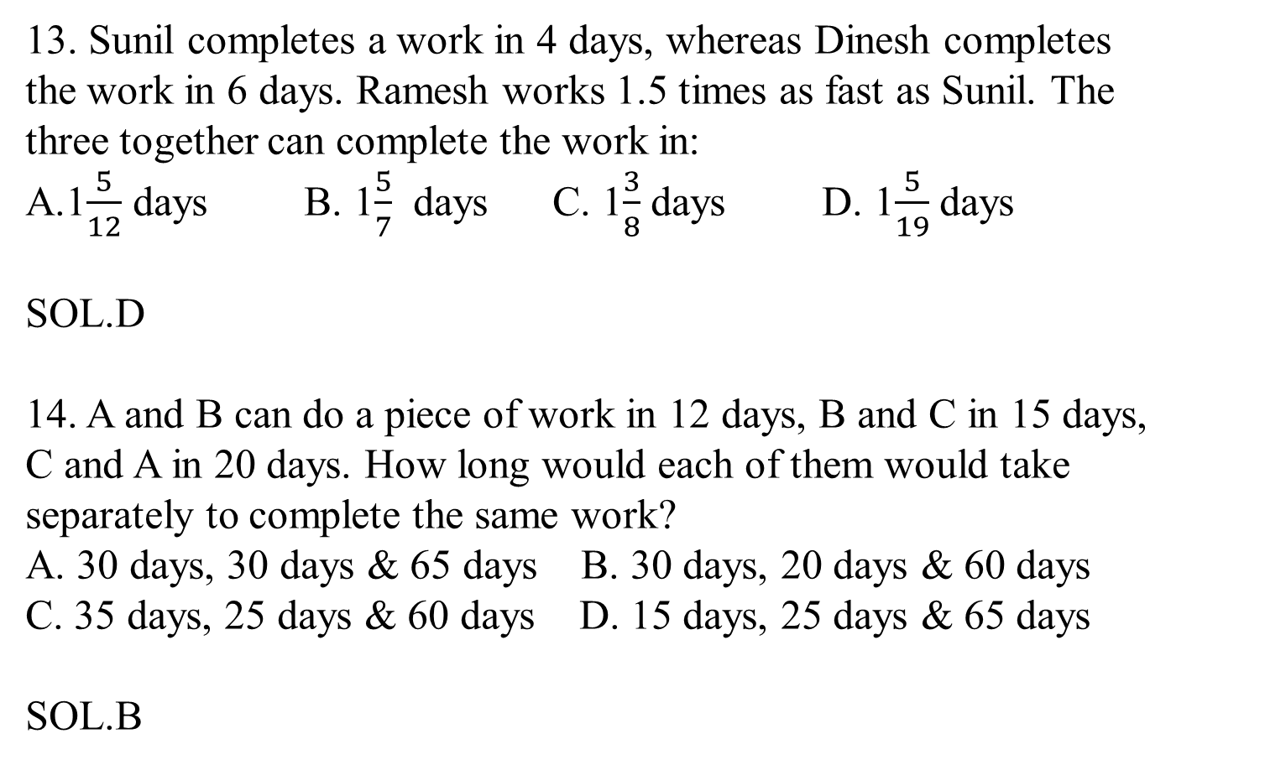
13. Sunil completes a work in 4 days, whereas Dinesh completes the work in 6 days. Ramesh works 1.5 times as fast as Sunil. The three together can complete the work in:
A.1$\frac{5}{12}$ days B. 1$\frac{5}{7}$ days C. 1$\frac{3}{8}$ days D. 1$\frac{5}{19}$ days
SOL.D
14. A and B can do a piece of work in 12 days, B and C in 15 days, C and A in 20 days. How long would each of them would take separately to complete the same work?
A. 30 days, 30 days & 65 days B. 30 days, 20 days & 60 days
C. 35 days, 25 days & 60 days D. 15 days, 25 days & 65 days
SOL.B
Notes:
13. Time taken by ramesh =4*2/3=8/3 days
Work done by all the three in 1 day
¼+1/6+3/8=19/24
Required time=24/19=1(5/19) days.
14. A+B = 12 B+C = 15 A+C = 20
Lcm of (12,15,20) = 60 Efficiency is A+B = 5 B+C = 4 A+C = 3
Total efficiency 2 (A+B+C) = 12 A+B+C = 6
Individual efficiency A = 6 - 4 = 2 B = 6 - 3 = 3 C = 6 - 5 = 1
Individual time taken A = 60/2 = 30 days B =60/3 = 20 days C = 60/1 = 60 days

Slide 27
15. Harbans Lal can do a piece of work in 24 days. If Bansi Lal works twice as fast as Harbans Lal, then how long would they take to complete the work working together?
8 days B. 12 days C. 6 days D. 4 days
SOL. A
16. A complete 3/4 of a work in 12 days. In how many days he would complete 1/8 of the work?
3 B. 2 C. 1 D.4
SOL.B
Notes:
15.Here x=24, k=2
Together time taken be=(x/1+k)days
8 days
16. Here a=3, b=4, x=12, c=1 and d=8
Therefore, number of days required to complete 1/8 of the work
=b*c*x/a*d=4*1*12/3*8=2 days.

Slide 28
17. If 10 persons can cut 20 trees in 3 days by working 12 hours a day. Then, in how many days can 24 persons cut 32 trees by working 4 hours a day?
6 B. 5 C. 7 D.8
SOL. A
Notes:
19.M1D1T1W2=M2D2T2W1
10*3*12*32=24*D2*4*20
D2=6 days
20. LCM = 60
Efficiency of A and B = 6 and 5
And eff of C = -3
Time = 60/8 = 7.5

Slide 29
HOT (Higher Order Thinking) Question
A takes 16 days to finish a job alone, while B takes 8 days to finish the same job. What is the ratio of their efficiency and who is less efficient?

Slide 30
In the beginning, Ram works at a rate such that he can finish a piece of work in 24 hrs, but he only works at this rate for 16 hrs. After that, he works at a rate such that he can do the whole work in 18 hrs. If Ram is to finish this work at a stretch, how many hours will he take to finish this work? 1) 12 hrs 2) 18 hrs 3) 11½ hrs 4) 15 hrs 5) 22 hrs

Slide 31
A can do a piece of work in 10 days, and B can do the same work in 20 days. With the help of C, they finished the work in 4 days. C can do the work in how many days, working alone? 1. 5 days 2. 10 days 3. 15 days 4. 20 days 5. 25 days

Slide 32
A can do a piece of work in 12 days. B can do this work in 16 days. A started the work alone. After how many days should B join him, so that the work is finished in 9 days? 1. 2 days 2. 3 days 3. 4 days 4. 5 days 5. 1 days

Slide 33
A and B can do a piece of work in 4 days, while C and D can do the same work in 12 days. In how many days will A, B, C and D do it together? 1. 12 days 2. 4 days 3. 3 days 4. 2 days 5. None of these

Slide 34
A and B can do a piece of work in 40 days, B and C can do it in 120 days. If B alone can do it in 180 daysa, in how many days will A and C do it together? 1. 45 days 2. 22.5 days 3. 25 days 4. 18 days 5. 12 days

Slide 35
A, B, C, and D can do a piece of work in 20 days. If A and B can do it together in 50 days, and C alone in 60 days, find the time in which D alone can do it. 1. 120 days 2. 200 days 3. 150 days 4. 90 days 5. 75 days

Slide 36
Daku and Tamatar can do a piece of work in 70 and 60 days respectively. They began the work together, but Daku leaves after some days and Tamatar finished the remaining work in 47 days. After how many days did Daku leave? 1. 14 days 2. 16 days 3. 18 days 4. 10 days 5. 7 days

Slide 37
Ajay and Vijay undertake to do a piece of work for Rs. 480. Ajay alone can do it in 75 days while Vijay alone can do it in 40 days. With the help of Pradeep, they finish the work in 25 days. How much should Pradeep get for his work?

Slide 38
6 women can complete a piece of work in 10 days, whereas 10 children alone take 15 days to complete the same piece of work. How many days will 6 women and 10 children together take to complete the piece of work?

Slide 39
18 women can complete a work in 12 days and 12 men can complete the same work in 9 days. In how many days will 8 men and 8 women complete that work?

Slide 40
4 girls can do a piece of work in 8 days, same work 3 boys can do in 9 days, 7 men in 2 days and 5 women in 4 days. Who among them have the minimum capacity of work?

Slide 41
The hourly wages of a mason have increased by 25%. Since the increase, the number of hours he works daily has reduced by 16%. If he was earning Rs. 120 per day before the increase, how much (in Rs.) is he earning now?

Slide 42
Radhe does 70% of some work in 15 days. Later, with Shyam’s help, she completes the remaining work in 4 days. In how many days can Shyam alone complete the entire work?

Slide 43
It takes 6 workers a total of 10 hours to assemble a computer, with each working at the same rate. If six workers start at 9.00 am, and one worker per hour is added beginning at 3.00 pm, at what time will the computer assembled?

Slide 44
12 students working for 5 hours a day can solve a certain number of problems in 8 days. How many boys are needed to solve five times the original number of problems, if they work at 4 hours a day for 15 days?

Slide 45
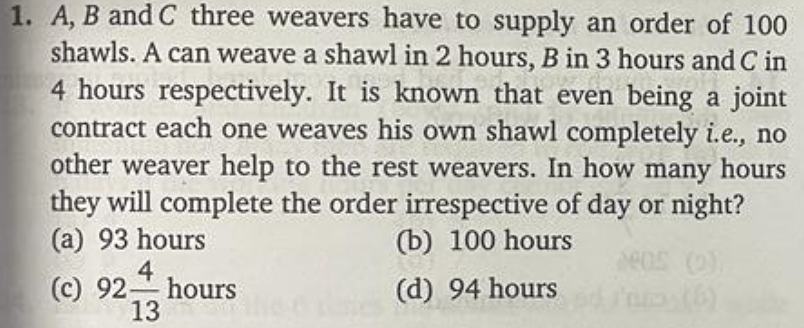

Slide 46
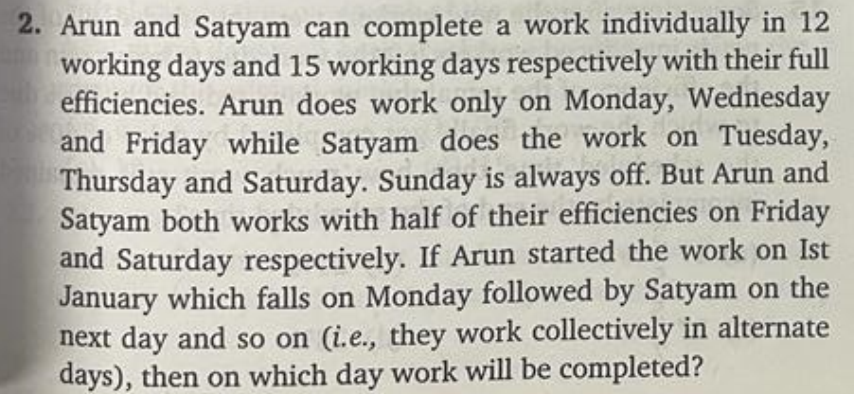

Slide 47
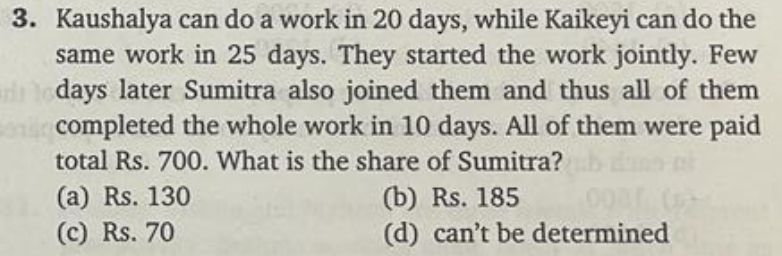

Slide 48
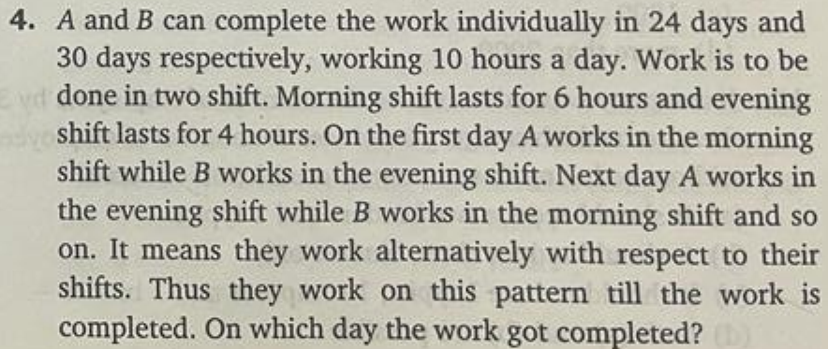
5. In the previous question, what percent of the time of the morning shift was utilised?

Slide 49


